Slide 1



Data Science Job Salaries
Avisha Singh - 2088371

Slide 2
Objective
The purpose is to analyze the average job salaries of Data Science Employees based on their experience level and job title varying from country to country. The idea is to get to know about the current market in Data Science over the period of time.

Slide 3
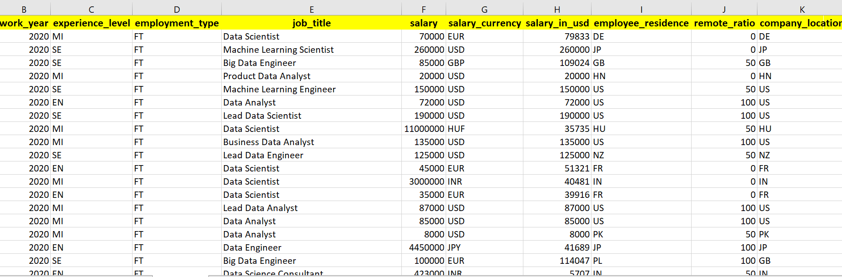
Dataset Description
The dataset is about the Data Science Job Salaries of employees with different experience levels and employment type.
It consists of Entry-level, Junior Mid-level, Intermediate Senior level, Expert Executive level and Director positions of employees.
It also tells about the work done remotely by these employees in different countries.

Slide 4
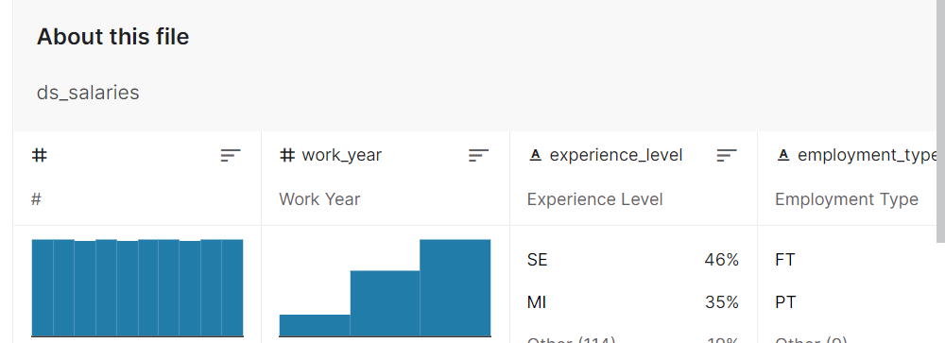
The data set has been taken from Kaggle, consisting of 608 rows and 12 attributes.
The dataset is useful for doing the analysis in order to discuss various aspects of data.
We get to know about highly paid data scientists country-wise over the period of time.
We could analyze which job title is in more demand by just comparing the gross salary paid.

Slide 5
Visualization Using Tufte’s and Colin Ware’s Theories

Slide 6
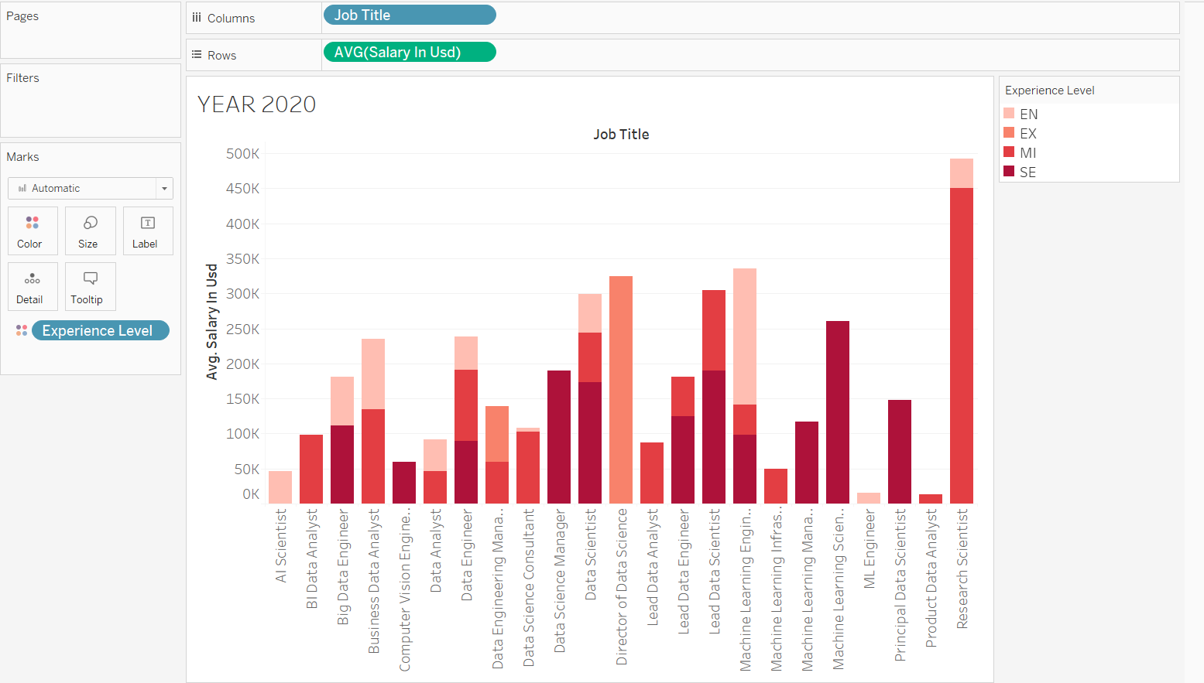
Visualization 1
Visualization depicting the average salaries of data science employees with different experience levels and Job titles for the year 2020.
We can conclude that the average salary in USD for entry-level to executive-level positions for most of the job titles is higher than the senior-level position for the year 2020.

Slide 7
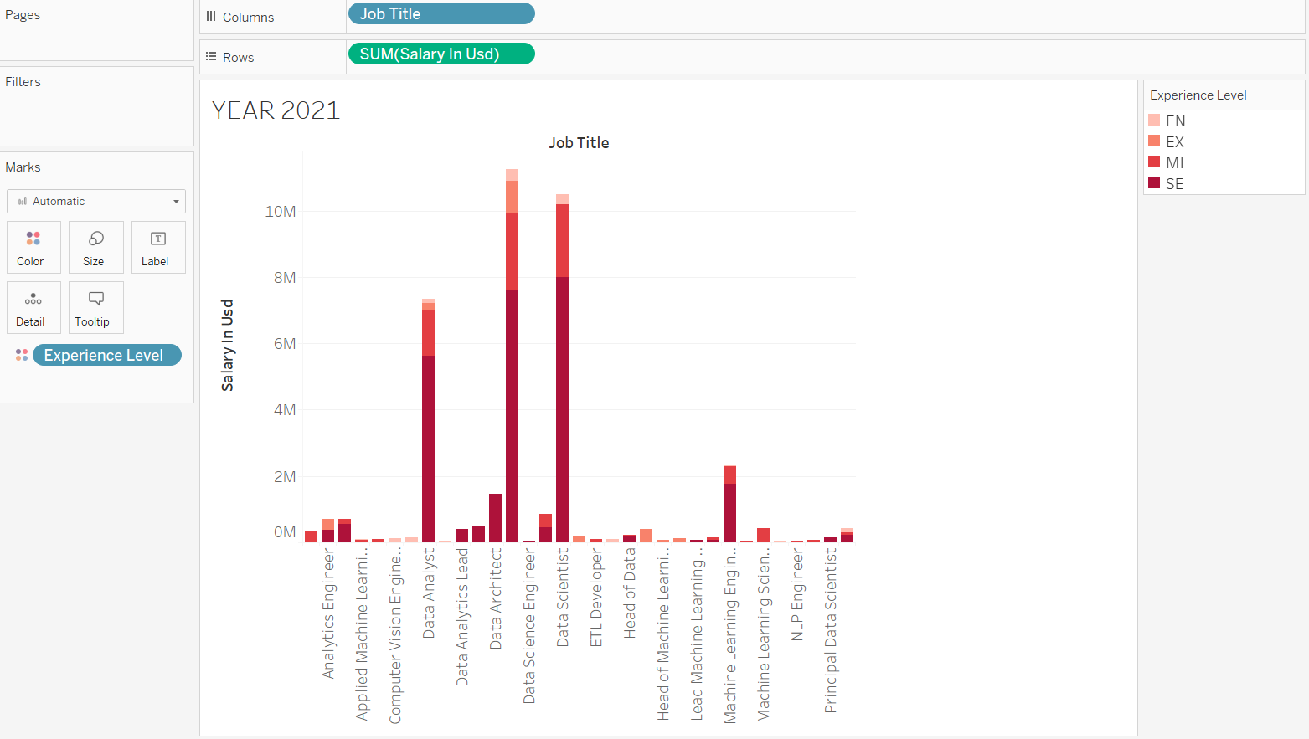
Visualization 2
The stacked bars toolbar is used to analyze the experience levels in different colors for the year 2021.
The labels are added for job titles depicting the average salaries in USD for the year 2021.

Slide 8
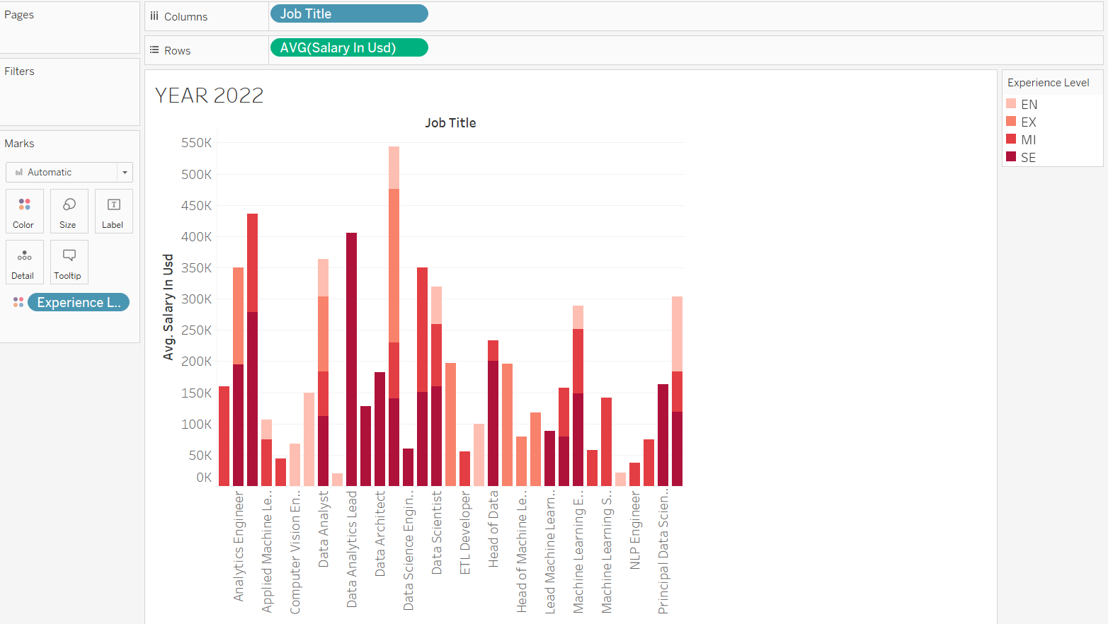
Visualization 3
Here in this, it is depicting the average salaries of data science employees with different experience levels and Job titles for the year 2022.
We can see the change in the salaries of employees for the year 2022. The average salary in USD for senior-level positions is rising.

Slide 9
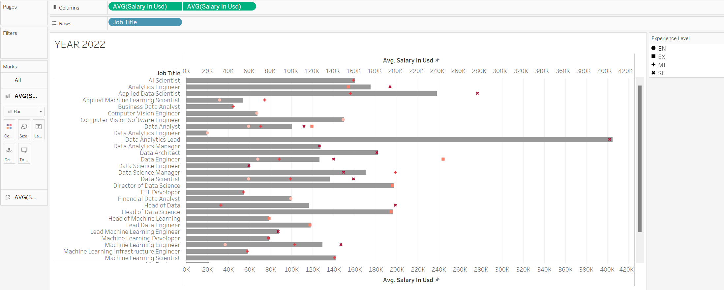
Glyphs
The glyphs are representing different experience level positions, each in different shapes.
The circle-shaped glyph is indicating an entry-level position, the square shape is indicating executive level, plus sign is indicating mid-level and the cross sign is indicating the senior level position for average salaries.

Slide 10
Principles of Tufte’s and Colin Ware’s theory
By following Tufte’s theory we are able to visualize the data in such a way that it can provide us with the best outcomes in an understandable way and also by maintaining graphical excellence during the visualization. Hence, by following his principles we are able to improve the quality of visualization.
The visualization consists of large data sets as mentioned in Tufte’s theory that reveals the data at several levels of detail from a broader overview.
By following Colin Ware’s principle, we are able to apply theories of perception to the design of data visualizations by using glyphs.
The different facets of visual perception like color, texture and organization are used.

Slide 11
Improvements
The comparison analysis has been done from the year 2020 through the year 2022, which helps us to do the analysis over the years.
The dataset has been filtered for individual years like 2020, 2021, and 2022.
We can observe the change in the average salaries at different positions for different job titles.
At last, glyphs are added to visually analyze the average salaries with the help of various shapes.

Slide 12
Hypothesis
Hypothesis:- Gradually, there has been a rise in the average salaries of employees starting from entry-level to senior-level over the years.
The dataset is proving the hypothesis which can be seen in the visualization of different years.
This can be proved as the bar is rising for a senior-level position in the year 2022 depicting the average salary of employees.

Slide 13
THANK YOU!

